Slide 1
Web Dashboards
ELEE2045
3/23/2026

Slide 2
HTML
Stands for HyperText Markup Language and is used for the ‘front-end’ or client side. ( what the user sees)

Slide 3
<!DOCTYPE html>
<html lang="en">
<head>
<title>
hello, title
</title>
</head>
<body>
hello, ELEE2045
</body>
</html>

Slide 4
Tags
A tag is a piece of text inside angle brackets <>
Opening tag: <
Closing tag />
E.g :
<p>
This is a paragraph
</p>

Slide 5
Attributes
Attributes are name value pairs that modify the tag. For example:
<img src=“my_image.jpg” Alt = “this is an image” />
src attribute describes where the image can be found
alt attribute describes the alternate text to display when the image is unavailable

Slide 6
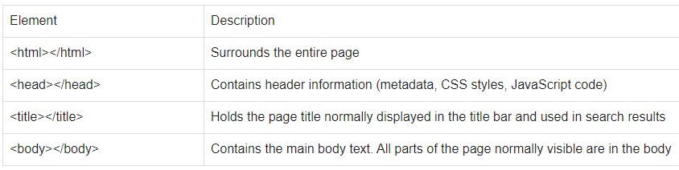
Structure of an HTML page: Required

Slide 7
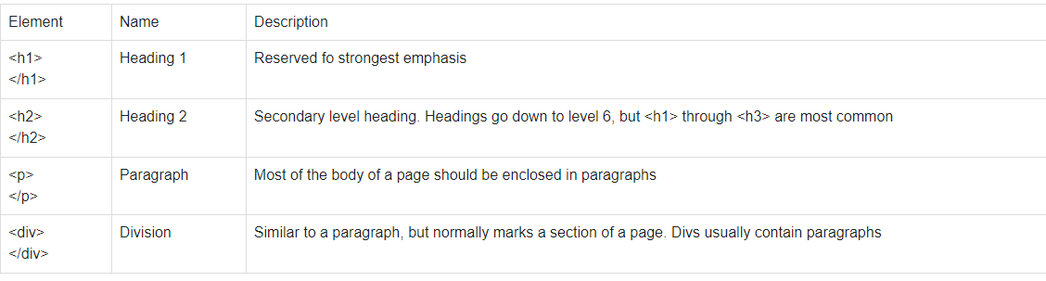
Structure of an HTML page: key elements

Slide 8
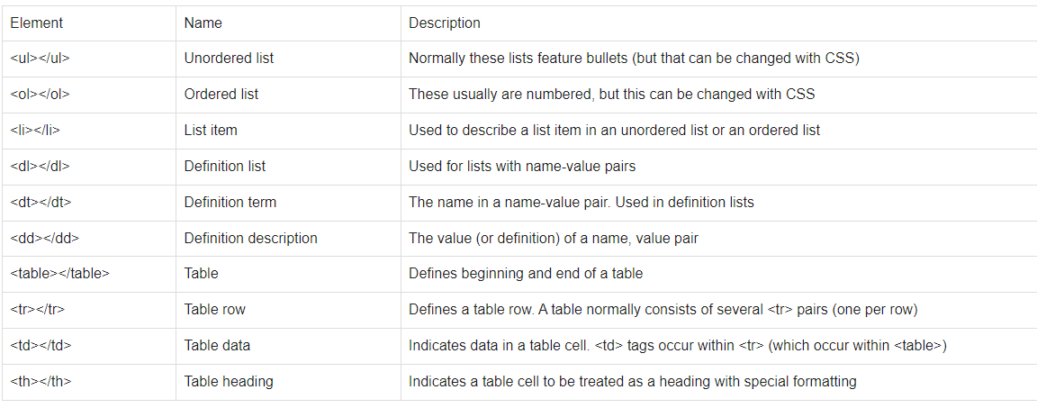
Lists and Data

Slide 9
The <a> anchor element
It has the href attribute, and it creates a hyperlink to webpages, files, email addresses or anything
E.g. <a href="https://vel.engr.uga.edu/">VEL</a>

Slide 10
Simple/base web page
<!DOCTYPE html>
<html lang="en">
<header>
<title>Title</title>
</header>
<body>
</body>
</html>

Slide 11
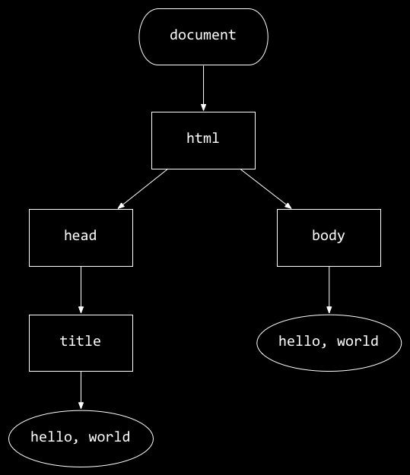
<!DOCTYPE html>
Simple/base web page
<html lang="en">
<head>
<title>
hello, title
</title>
</head>
<body>
hello, ELEE2045
</body>
</html>
hello, body
hello, title

Slide 12
Styling (CSS)
CSS: Cascading Style sheets
CSS selectors find the elements you want to style

Slide 13
Ways to use CSS/Styling
You can inline style, as an attribute
You can include a <style> section in the <head> section
You can use a <link rel=“stylesheet” href=“location of css file”> to bring styling contained in another file in to your code.
Note this can be external, e.g bootstrap: <link href="https://cdn.jsdelivr.net/npm/bootstrap@5.3.0/dist/css/bootstrap.min.css" rel="stylesheet" integrity="sha384-9ndCyUaIbzAi2FUVXJi0CjmCapSmO7SnpJef0486qhLnuZ2cdeRhO02iuK6FUUVM" crossorigin="anonymous">
Bootstrap link: https://getbootstrap.com/docs/4.3/getting-started/introduction/

Slide 14
<!DOCTYPE html>
<html lang="en">
<head>
<style>
</style>
<title>
hello, title
</title>
</head>
<body>
hello, ELEE2045
</body>
</html>

Slide 15
<!DOCTYPE html>
<html lang="en">
<head>
<link href="styles.css" rel="stylesheet">
<title>
hello, title
</title>
</head>
<body>
hello, ELEE2045
</body>
</html>

Slide 16
Element selectors
e.g.
div{
text-align: center
font-size: 34
font-weight:bold
}

Slide 17
Class Selector (.)
.class_name{
}

Slide 18
Id selector (#)
#shout{
text-align:center;
color: red;
}

Slide 19
Descendants
e.g
ol > ul {
color: blue;
}
#container > div {
}

Slide 20
Responsive Pages
Use the @media query to change the styling based on the size/type of screen
Ref: https://www.w3schools.com/cssref/css3_pr_mediaquery.php

Slide 21
Next
Flask backend
Inheritance and control flow using jinja
Getting data from forms
Sending data to our web pages
Navigating between our pages
All these encapsulated in student detail example

Slide 22
Simplest Flask App
from flask import Flask
app = Flask(__name__)
@app.route('/')
def index():
return 'Hello. world!'
if __name__ =='__main__':
app.run(debug=True)
decorator
Corresponding function

Slide 23
render_template
Renders a html page on the browser

Slide 24
url_for()
Import it from the flask module
It allows you to dynamically create a url for a function in your python file. For example if you have:
App.route(‘/view’)
Def view_records():
Return render_template(‘view.html’)
You can get the url for the view_records() function anywhere in the python file through: url_for(‘view_records’).
You can get the same url in html files using jinja: {{url_for(‘view_records’)}}
The first argument is the function name, followed by the parameters that the function expects

Slide 25
Inherit from a template
{ extends “base.html” %} - include this line at the beginning of the inheriting page. Here base.html is the name of the base template that you want to inherit from.

Slide 26
redirect
You can redirect the user to a route using the redirect function
E.g if you have two routes:
@app.route(‘/admin/’)
def hello_admin():
Return ‘hello admin’
@app.route(‘/user/<name>’):
Def hello_user(name):
If name == ‘admin’:
return redirect(‘/admin’)
# or return redirect(url_for(‘hello_admin’))

Slide 27
Passing arguments in Redirect
Import request
Use request.args.get(‘variable_name’) to get the argument by name

Slide 28
Variables from links
Include variables in <angled brackets>
E.g
@app.route(‘/students/<name>/<grade>’):
Def Handle_Student(name, grade):
If name==‘admin’:
#do something
# or
Return render_template()

Slide 29
Jinja templates
They allow you to create a base template that you can build the rest of your pages on
Put your pages in a folder called ‘templates’ for jinja to automatically detect them
Use{%include ‘page_name.html’ % } to bring in code from a html page as is
Use {% extends ‘page_name.html’ %} to inherit from and extend a html base page

Slide 30
Form elements
These allow you to get data from users:
<form action = “{{url_for(my_function)}}” method =”post”>
Action: this is the link/route that gets called in the backend app to handle when the user hits the submit button.
Method: either post or get etc
<input type=‘text’ name=‘variable_name’ id=“my_id” autofocus

Slide 31
label
<label for="first_name">First Name</label>
Label is a text element usually used to label other elements
For: the id of the element this label belongs to
First Name is the literal text of the label that’s rendered by the html page

Slide 32
input
<input name = "first_name" id="first_name" type="text" autofocus placeholder="First Name">
Name: variable name for access in python
Id: selector that allows it to be styled or referenced by other items e.g. labels
Type: text, number, list

Slide 33
select
Allows the user to select from a set of options:
<select name="level">
<option value="undergraduate">Undergrad</option>
<option value="graduate">Grad</option>
</select>
In above example, name is the variable name we use in python app to access the user input
Option: the different option that a user can select

Slide 34
Input (list)
<input name="Favorite Color" list="colorlist" placeholder="Color">
<datalist id = "colorlist">
<option value="red">red</option>
<option value="green">green</option>
<option value="blue">blue</option>
</datalist>
This is a mix between select and input.

Slide 35
Python in html using jinja?
Variables: these are enclosed in double curly braces like this {{ variable_name}}
For loop: {% for item in my_collection %} do stuff {% endfor %}
Conditionals: {% if condition %} do stuff {%elif condition %} do some other stuff {% endif %}

